Slide 1
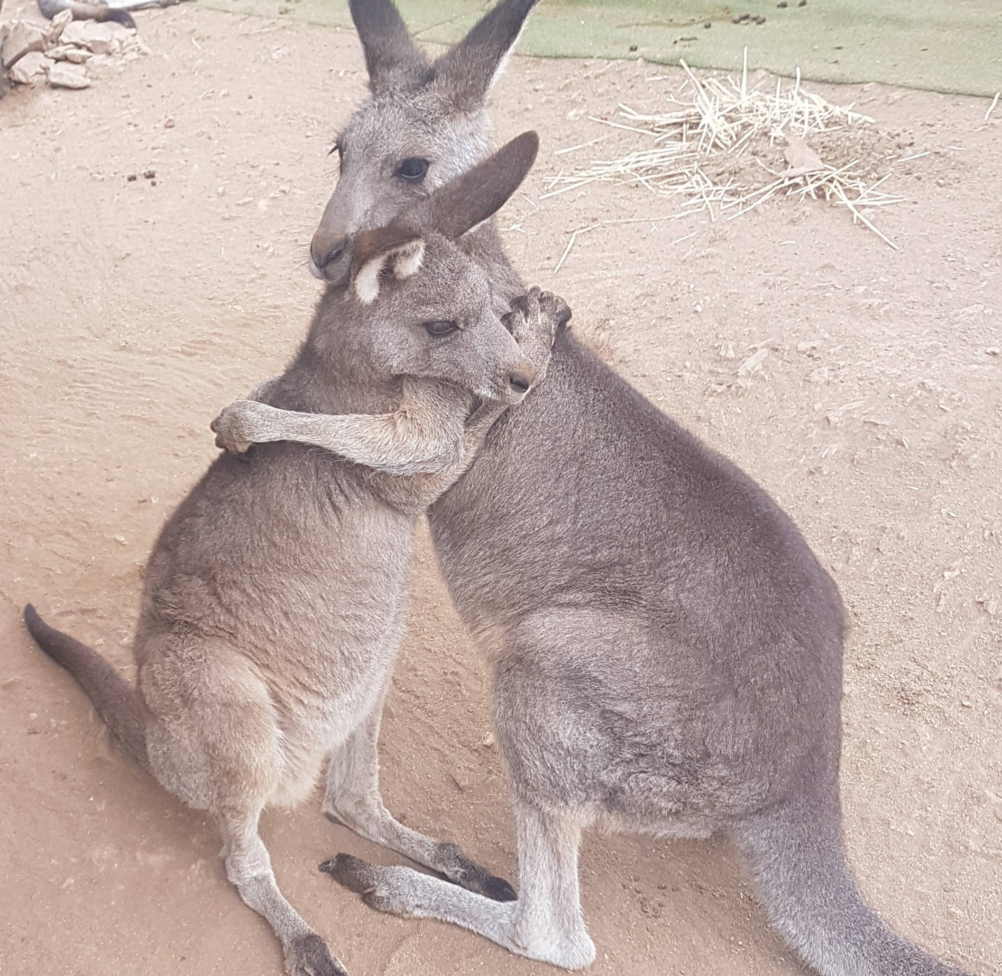
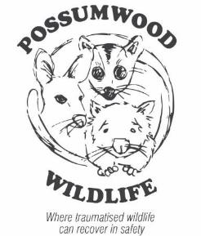
Kangaroo Emotions, Stress, the Polyvagal Theory and Rehabilitation

Slide 2
The emotional lives of kangaroos
[Ref: Garlick, S. and Austen, R. “Learning about the emotional lives of kangaroos, cognitive justice and environmental sustainability”. Journal of Relations: Beyond Anthropocentricism, 2014, 2 (1).]
Emotions are not spontaneous upwellings of arbitrary feelings. They are reactions to events. So if we can correlate emotional reactions with the events that trigger them, we can use these reactions as sources of information to help in recovery.
The emotional life of an animal is just as important for recovery as is his/her physical life.
The veterinarian cant help you with that. Its your job to engage with it.

Slide 3
Emotional Behaviour
Six neural markers identified for kangaroos (joy, separation, anger, relaxation, nurturance, sexuality).
Each has a number of behavioural indicators (see table next slide)

Slide 4
Emotional Behaviour Markers in the Kangaroo
Neural states | Outward indicators (kangaroo)
Joy (play) | Hooning, kicking legs into the air, boxing with kin, chasing kin, eye expression.
Separation, distress (panic) | Vocal, running into objects in panic, eye expression, erect and extended posture, licking forearms, rapid respiratory rate, flared nostrils.
Nurturance (care) | Preening, embracing kin, body contact, protective behaviour by dominant males
Sexuality (lust) | Courtship behaviour, pairing, long-term male/female friendships
Anger (rage) | Vocal, eye expression, posture
Relaxation | Lying on back asleep, mothers relaxing pouch muscle, mothers allowing small infants to exercise outside pouch

Slide 5
Not all severe trauma outcomes were explainable
Some animals fade away to death while others thrive following severe trauma.
Our observations of kangaroos indicate that their personality traits vary greatly.
It is known that animals with a genetic predisposition to anxiety show more shutdown.
The simple sympathetic fight or flight and parasympathetic rest and digest states did not explain all our observations of post-trauma outcomes.

Slide 6
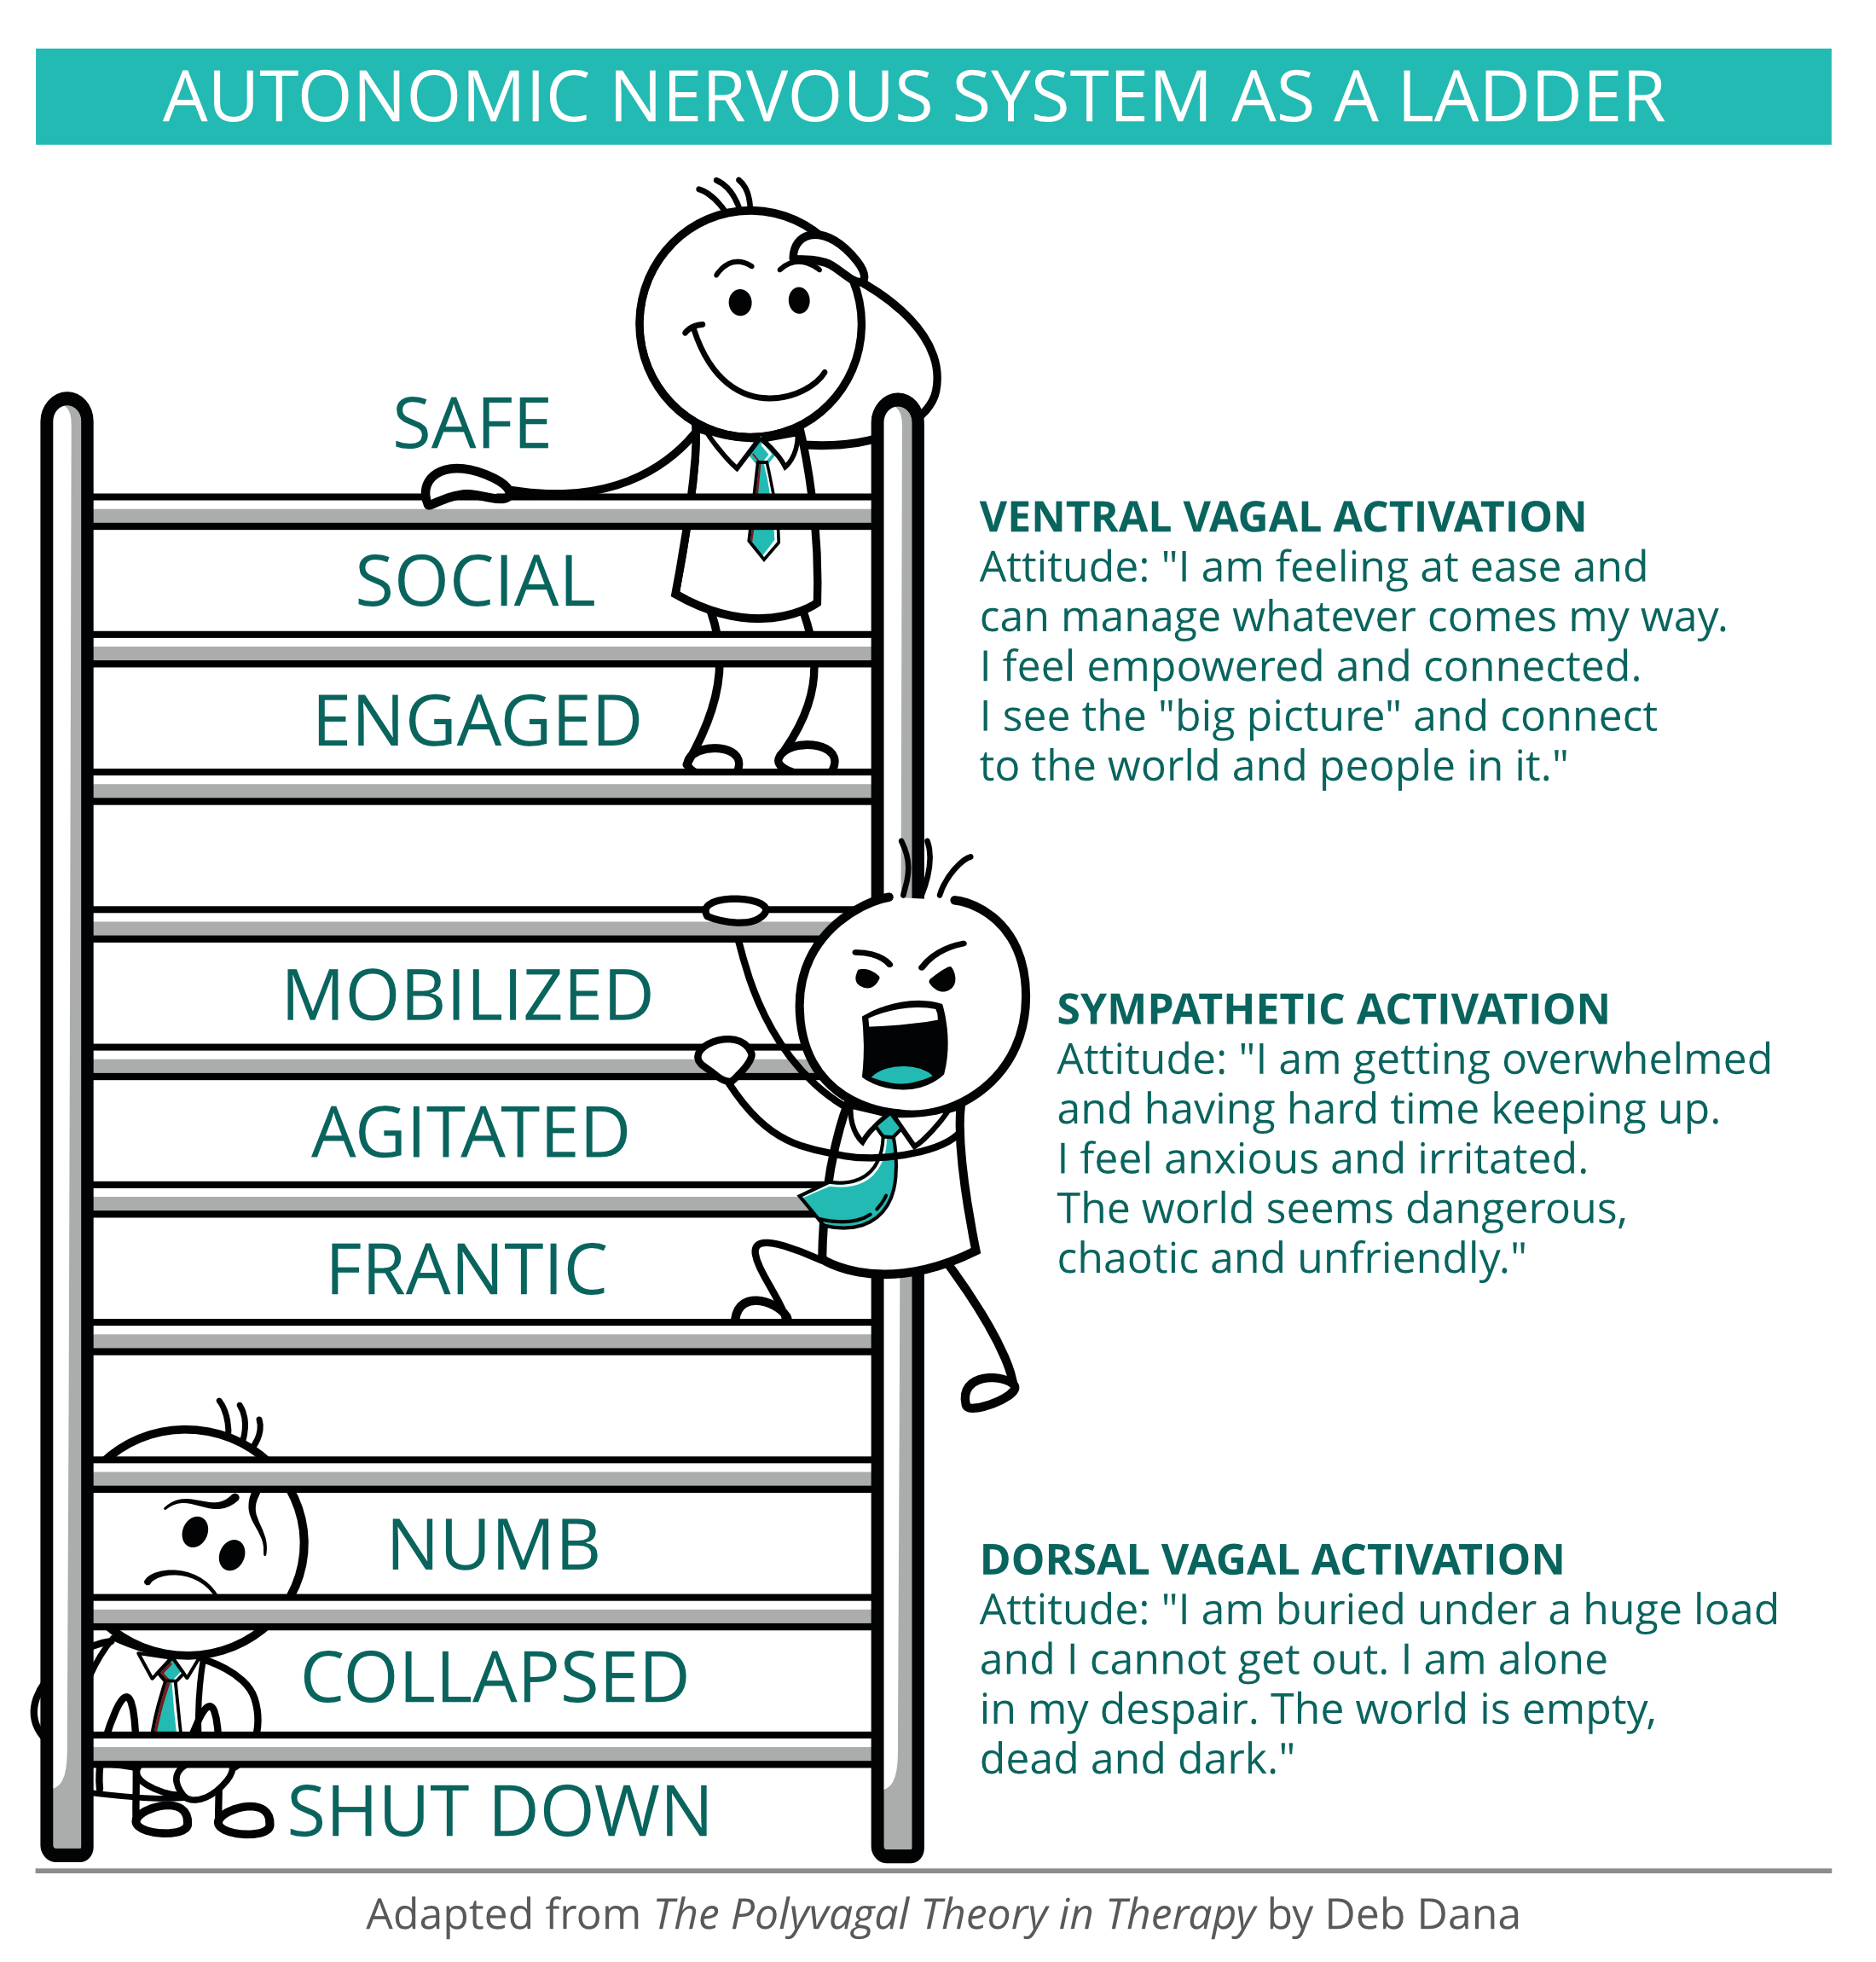
The Polyvagal Theory
The autonomic nervous system
Sympathetic & Parasympathetic nervous systems
The Vagus nerves of the parasympathetic nervous system
Ventral vagus branch -
Dorsal vagus branch –
The Polyvagal Ladder – a continuous loop of emotional &
behavioural movement between three states
Rest & digest (social engagement & rest)
Fight or flight (mobilisation)
Shutdown (immobilisation) –trance-like

Slide 7
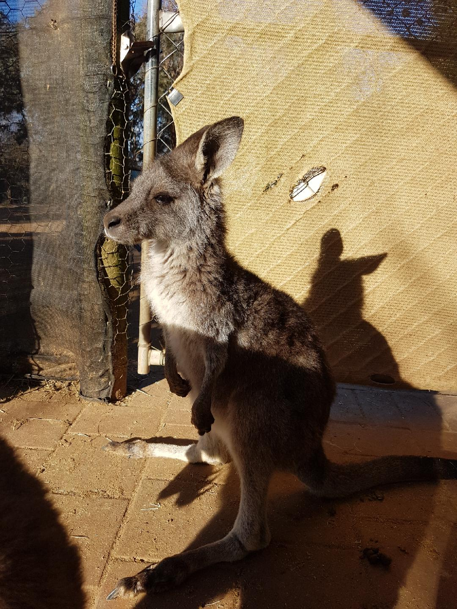
Relevance of Polyvagal theory to kangaroo rehabilitation
Explains some of the outcomes we have seen in kangaroos who have experienced trauma
The animal coming into care never switches from fight/ flight to rest/ engagement. When exposed to another stressor, even if minor, they can die rapidly (eg. Iggy).
The animal coming into care remains in shutdown (detached, hypothermic, bradycardic, bradypnea).
How can we get the animal from shutdown back to flight/ fight state? Query adrenalin
Instructs us in the best way to rehabilitate a social animal like a kanagaroo.
Recovery is boosted when stressors are removed and engagement with kin is fostered (eg. Housing indoors with other relaxed animals such as we saw with the fire victims to be discussed in the Burns presentation later)
New animals coming into care take their cues from existing relaxed in-care animals eg. The presence of older animals is relevant here.
Digby

Slide 8
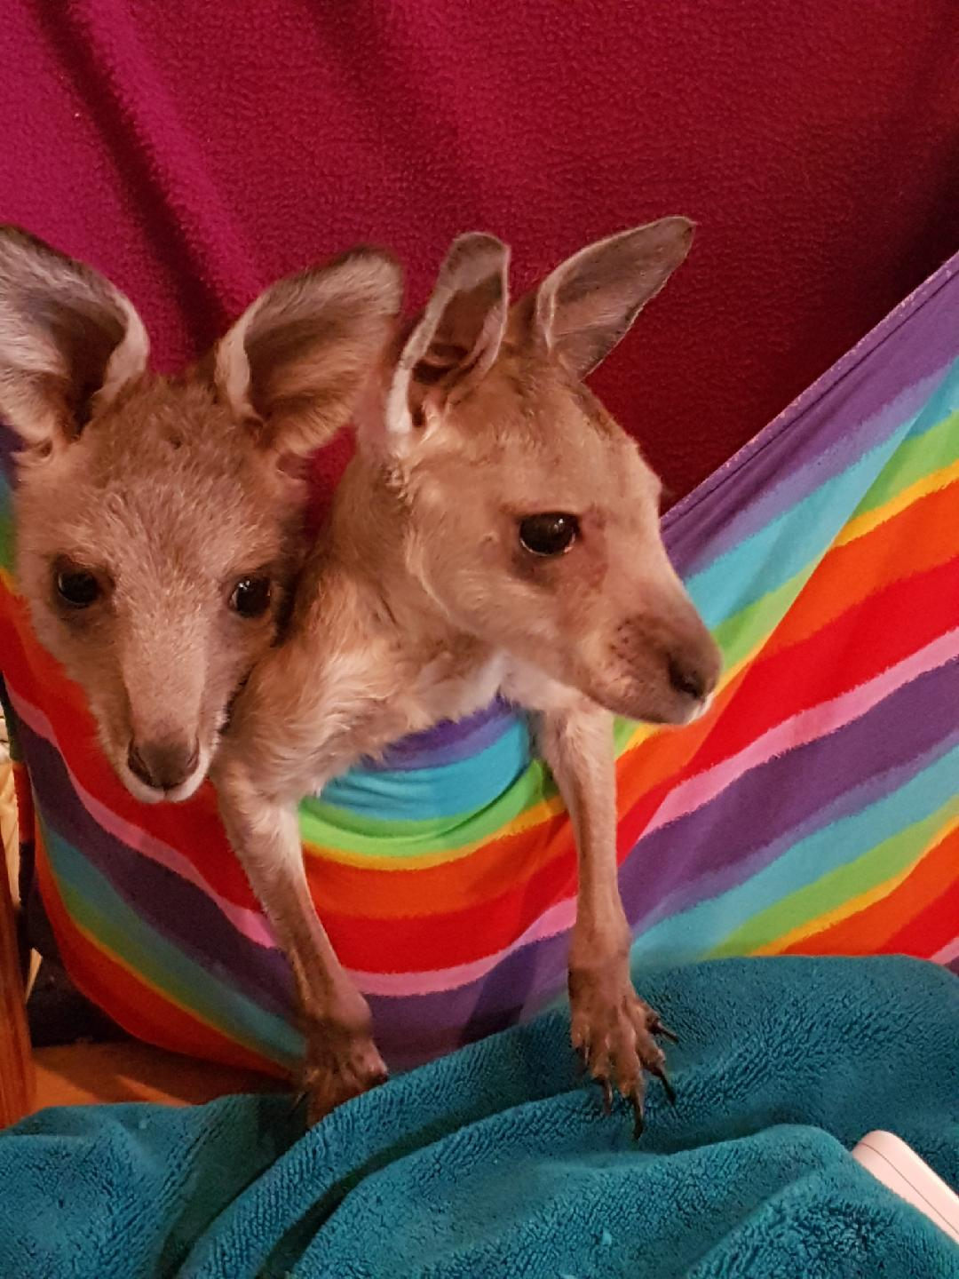
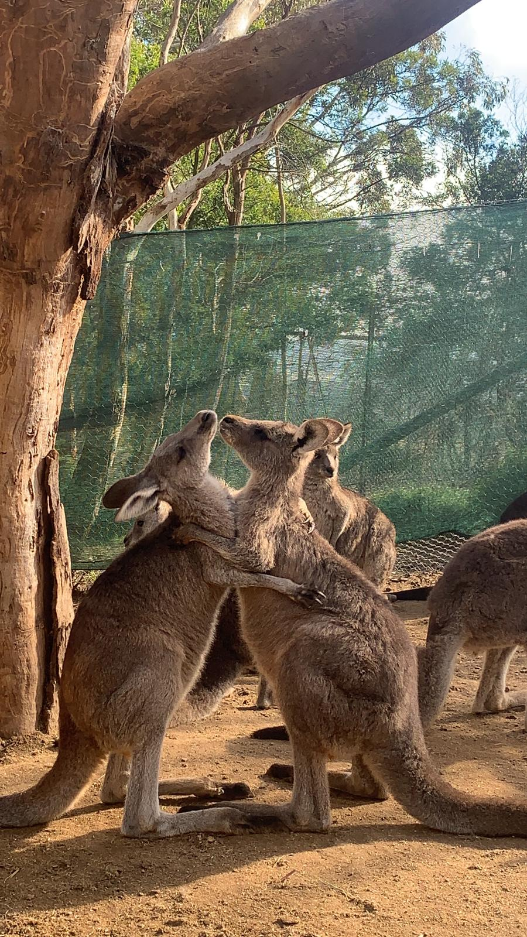
Rest & digest (safe, socially engaged) Parasympathetic - Ventral Vagal

Slide 9
Mobilised, Agitated, Frantic Flight & Fight (Sympathetic)

Slide 10
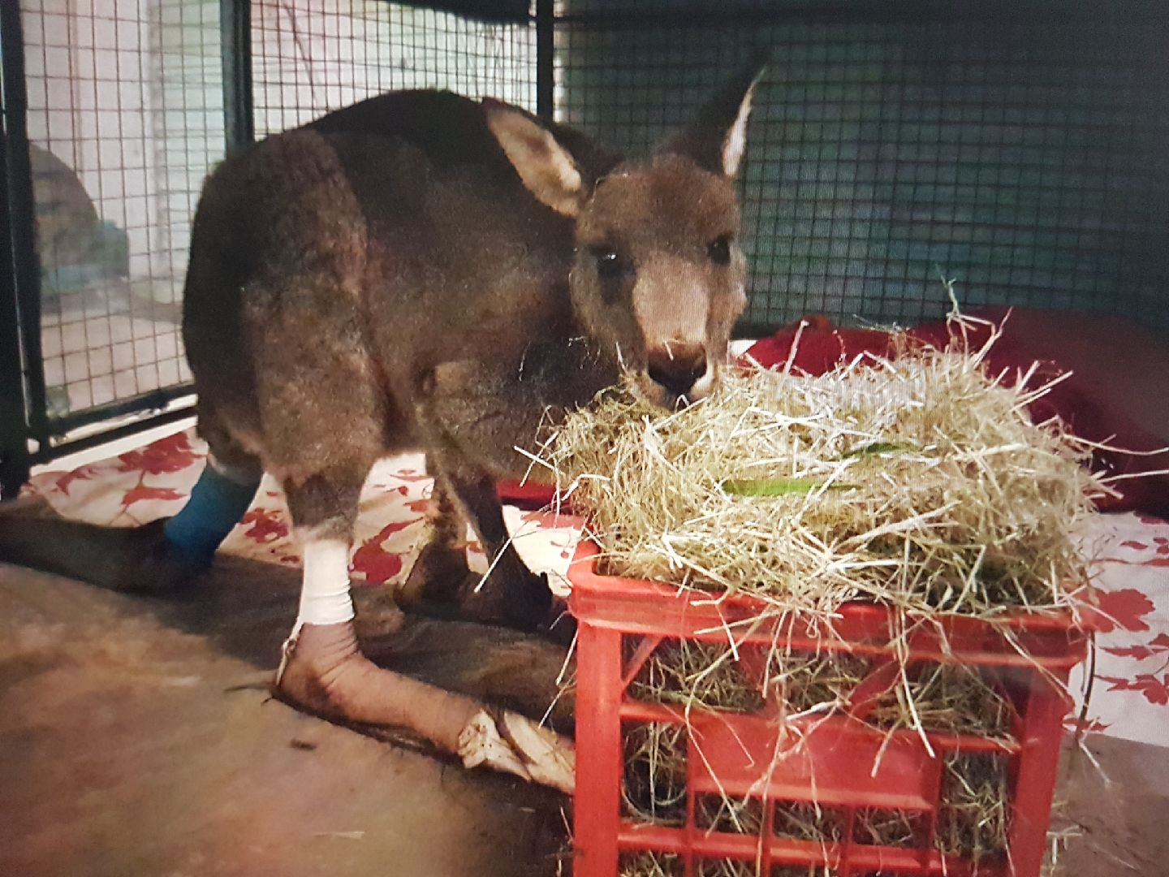
Shutdown, Frozen (Dorsal Vagal)

Slide 11
An example of the Polyvagal theory in action
Cherry Blossom. Attacked by two Maremma dogs. When rescued she was suffering from exertional rhabdomyolysis (indicated by the very high CK). She was in a sympathetic flight or fight state (indicated by the very high cortisol. You can see that over time the exertional rhabdomyolysis is resolved as shown by the decrease in the CK. She was housed inside with three other quiet macropods and received a lot of gentle attention from her carers. Her anxiety decreased as evidenced by the drop in cortisol (a switch from the sympathetic to the parasympathetic ventral vagal state.
Date | CK | CORT
5/7/22 | 139,826 | 242
6/7/22 | 52,253 | 154
11/7/22 | 8351 | 96
22/7/22 | 705 | 59
CK Normal 280 – 2790 U/L
CORT Normal < 50nmol

