Slide 1
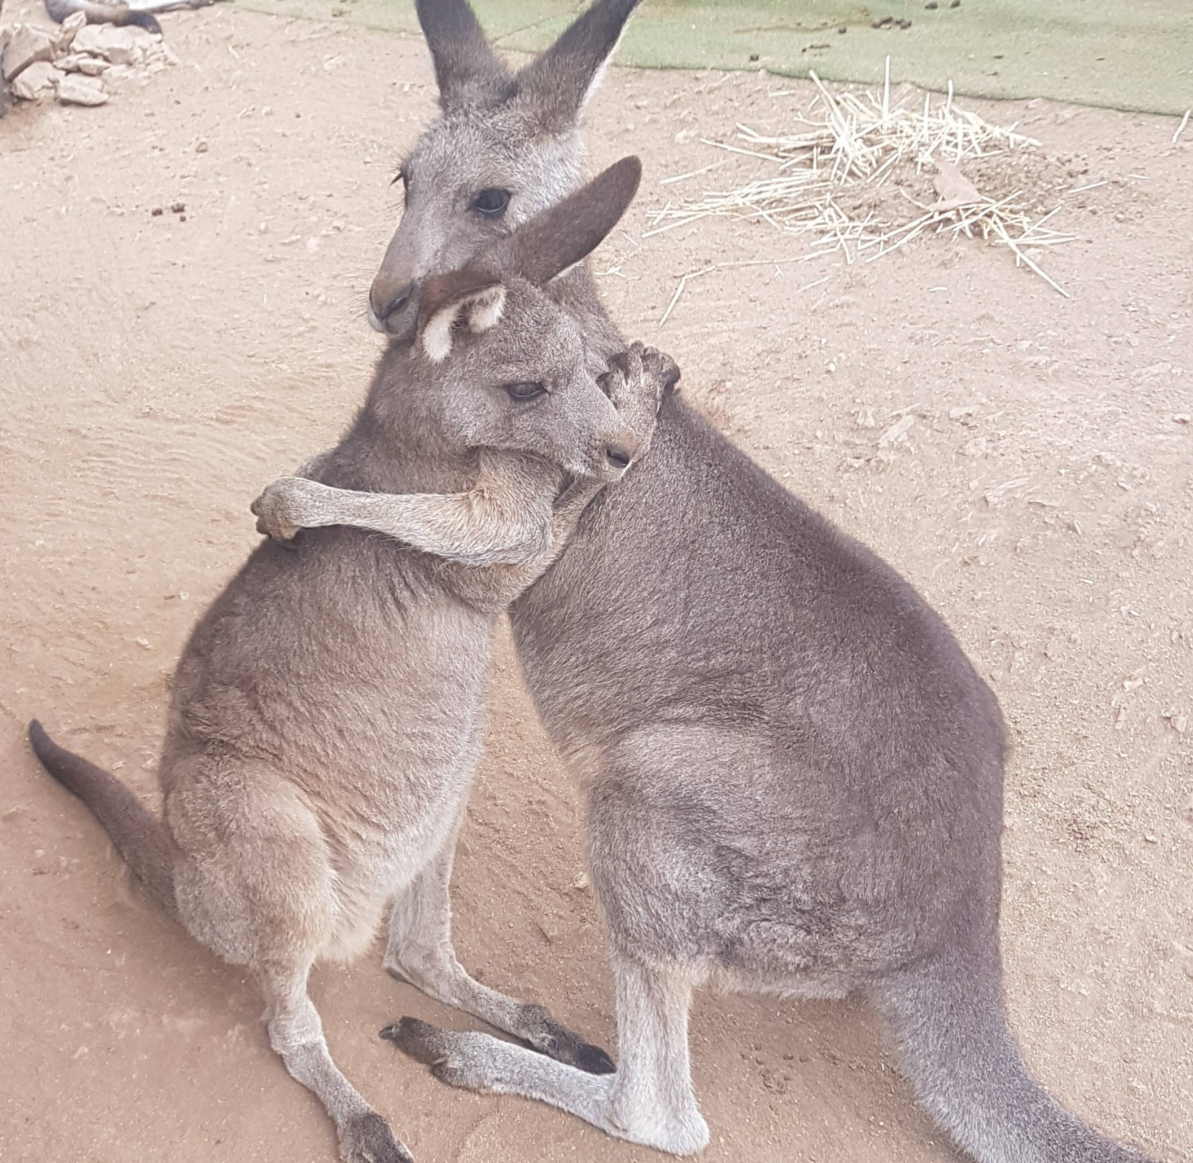
Advanced Macropod Training Course, 31 July, 2022
Dr Rosemary Austen
rosemaryausten60@gmail.com
0427204199
Prof Steve Garlick
Steve.c.garlick@gmail.com
0428880564

Slide 2
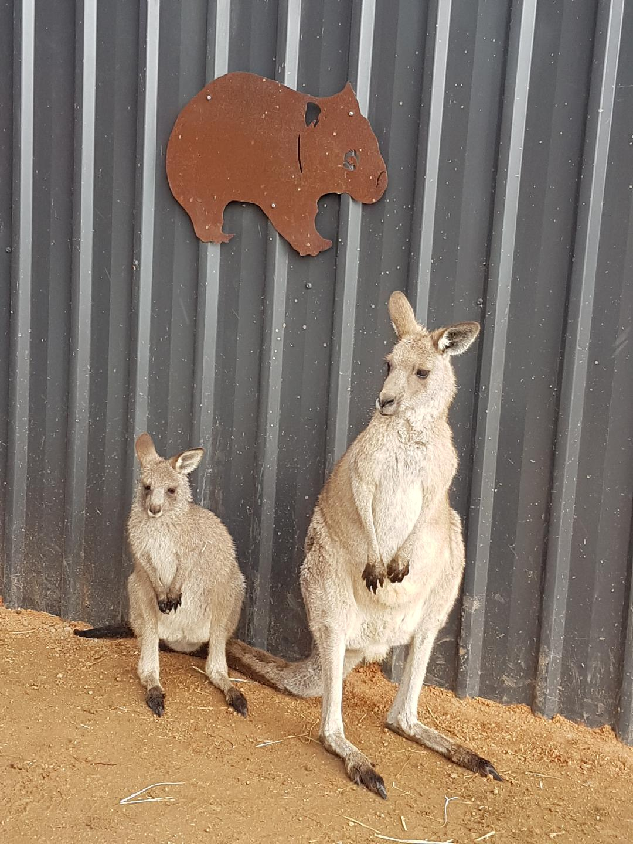
Welcome and Introduction
Rosemary & Steve
Possumwood (Vet Board licenced wildlife hospital and recovery centre)
22 years experience with a practical
focus on injury & illness.
Data & research
An advanced course with assumed knowledge…certificates of completion
A focus on Macropod stress – a theoretical framework and real cases
Warning- some pictures are confronting…but that’s the game we are in
Relax and enjoy the course….just like Mars.
Mars relaxing in style!

Slide 3
Our Values
Human exceptionalism has no place
Do no harm
Love & respect them
A ‘being-for’ relationship (‘teacher/ teacher’)
Wildlife knowledge systems
Tran-species learning through engagement

Slide 4
Program 9.00 Welcome 9. 9.00 Welcome 9.15 9.00 Welcome & introduction 9.15 Kangaroo emotions: Stress, the Polyvagal theory , and Rehabilitation 10.15 Stress syndromes in kangaroos 11.00 Break 11.15 Kangaroo Fence Entanglement: Rescue, Treatment. and Rehabilitation. 12.15 Q and A 12.30 Lunch 1.30 Burns – A Carer’s Perspective: Rescue, Treatment, and Rehabilitation. 2.15 Renal Failure in kangaroos 3.00 Herpes Virus 3.45 Q and A and other topics of interest 5.00 Close

