Slide 1
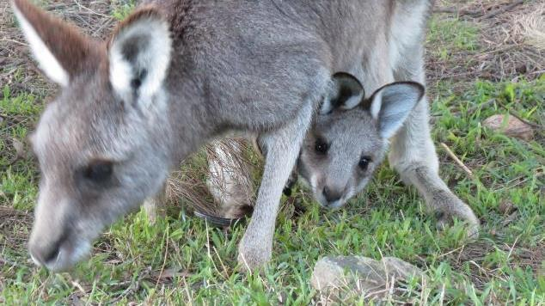
Stress Myopathy

Slide 2
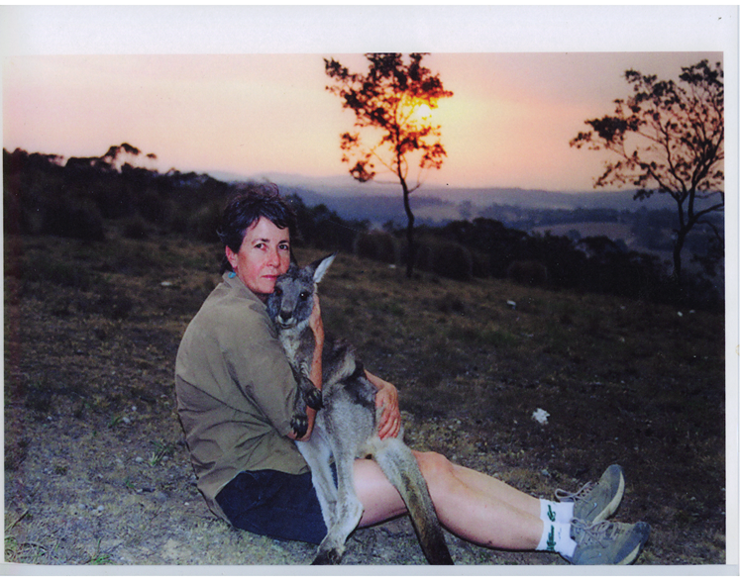
Rosemary & Rudi

Slide 3

Stress Myopathy
Pathophysiology not well understood
Major trigger – stress caused by fear or anxiety.
Risk enhanced by physical exertion.
Obvious causes – macropod caught in a fence or chased by a motor vehicle or dogs will definitely have stress myopathy. Severity and presentation varies.
Some causes more subtle eg change in carer, relocation to release site or certain noises.
Personality of the animal also plays a role in whether stress myopathy develops.

Slide 4
Important concepts
Two concepts are important in understanding the development of stress myopathy:
Sympathetic nervous system & the hormones adrenalin and cortisol
Aerobic & anaerobic metabolism

Slide 5
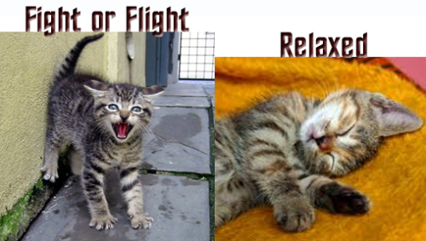
Fear factor
Fear & anxiety trigger the sympathetic nervous system & synthesis & release of hormones such as adrenalin and cortisol
Sympathetic - fight or flight
Parasympathetic – rest and digest

Slide 6
Fight or Flight Response
Amygdala Emotion Centre
Hypothalamus Control Centre
CRF
Sympathetic nervous system
Pituitary Gland
ACTH
Adrenal medulla
Adrenal cortex
Adrenalin
Cortisol
Bloodstream
Neural activity combines with hormones in the blood to constitute the fight or flight response

Slide 7
Sympathetic nervous system: Effects
Stimulates release of adrenalin
Stimulates glucose release from liver
Diverts blood away from GIT, kidneys and skin
Enhances blood flow to skeletal muscles (1200%) & lungs
Dilates bronchioles (airways) of lungs allowing better oxygen exchange
Increases heart rate and contractility of heart cells
Dilates cardiac blood vessels
Dilates pupils
Posturing in macropods

Slide 8
The Adrenalin Rush
Adrenalin contributes to the fight or flight response by:
increasing blood flow to the muscles
increasing output of the heart
pupil dilation
increasing blood glucose

Slide 9
Cortisol Contribution
Increasing blood pressure
Increasing blood glucose
Heightened attention
Decreasing sensitivity to pain
As an analogy with respect to the fight or flight response adrenalin puts the foot on the accelerator. As the initial adrenalin surge subsides, cortisol keeps the accelerator on. When the threat passes, the parasympathetic nervous system acts like a brake and dampens the stress response.

Slide 10
Cortisol readings
(*Possumwood research)
Normal = <50nmol/L
Name | History | Cortisol initial (nmol/ L)* | Cortisol follow up
Swallow | Dog attack, severe injuries | 531 | 56 (after 3 weeks)
Cherry | spinal injury, fox attack, joey taken & pouch torn | 522 | 62 (after 4 weeks)
Big Al | Attacked by 3 dogs | 431
Carrie | Fence hanger, dog attack | 525
Arrow | 70kg male with arrow penetrating eyelid | 24
Lily | Normal | 31
Josh | Fence hanger | 196

Slide 11
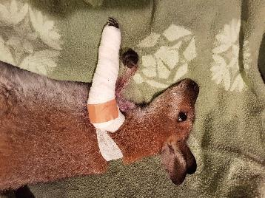
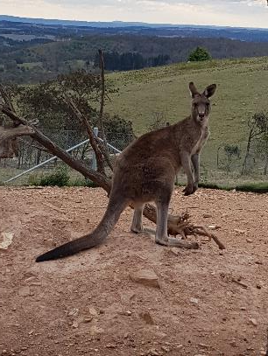
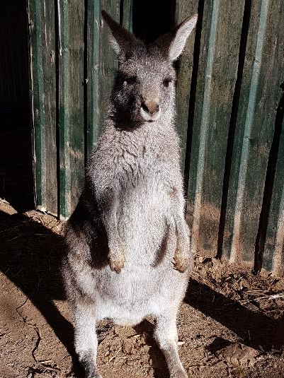
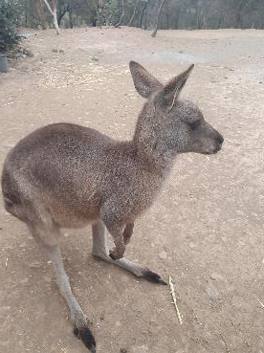
Cortisol case studies
Swallow
Big Al
Carrie
Lily

Slide 12
Aerobic metabolism
Glucose
Glycolysis – in cell cytoplasm
ATP (energy source) + Pyruvate + H⁺ (acid)
O₂
Krebs cycle
Electron transport chain –in cell mitochondria
CO₂ (exhaled during respiration) + H₂O + ATP (energy source)

Slide 13
Anaerobic metabolism
Glucose
Glycolysis – in cell cytoplasm
ATP (energy source) + Pyruvate + H⁺ (acid)
Lactate
OR
Creatine kinase (CK)
Creatine phosphate
Creatine + energy – in muscle cells
Phosphate + ADP
ATP (energy source)
Useful reference: http://www.teachpe.com/physiology/energy_systems.php

Slide 14
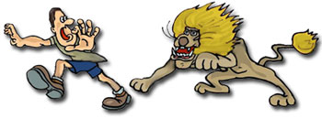
Stress myopathy - consequences
Fear or anxiety plus strenuous muscle activity cause sympathetic stimulation + Adrenalin + Anaerobic metabolism which have the following consequences
Tissue ischemia due to reduced tissue perfusion
Lactic acidosis
Muscular ATP (energy source) depletion
Muscle cell damage & consequent release of myoglobin & potassium
Compartment syndrome due to muscle swelling
Acid stimulation of nerve endings in muscles causing muscle pain
Rapid respiratory rate due to metabolic acidosis
Cardiac rhythm disturbance due to hyperkalemia (high potassium)
Hyperthermia (temp > 37 deg C)
Myoglobinuric nephrosis
Acute renal failure if severely dehydrated
Pulmonary oedema

Slide 15
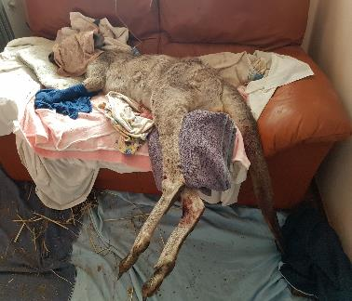
Stress Myopathy Syndromes#1*
Hyper acute
  Infrequent
  Genetic predisposition?
  Rapid respiratory & heart rate, hyperthermia, recumbency
  Metabolic acidosis, hyperkalemia, ventricular fibrillation
  Death within 6 hours of coming into care
Weroona. Fence hanger, Autumn day, had tachypnoea, tachycardia, temp 39.5. Died several hours after rescue. Given IV NS & sodium bicarbonate infusion, cooled with wet towels
* Syndromes based on Possumwood observations over 16 years and with reference to Breed, D. et al, Conservation Physiology, 7, 2019

Slide 16
Stress Myopathy Syndromes#2*
Per Acute
  Rare
  Previous stress & myopathy
  Rapid progression to death after a subsequent
  event (even mild).
  Iggy. Mother euthanased, alone for three days, harassed by dogs and then darted and brought into care at 3.5kg. Always hypervigilant, thought to have PTSD. After a minor stressor, Iggy developed shivering, dilated pupiIs, recumbency, muscle fasciculations.
Respiratory arrest & death within one hour.

Slide 17
Stress Myopathy Syndromes#3*
Acute
Most common
Severity & survival variable
Tachypnoea (rapid respiratory rate). One cause which can be
fatal if not treated with sodium bicarbonate sterile infusion
is lactic acidosis.
H⁺ + HCO₃⁻ CO₂ + H₂O
Tachycardia
Brown ‘Coca Cola’ urine
Stiff limbs
Pain - appears uncomfortable eg stretching hind legs
Muscle fasciculation
Elevated CK

Slide 18
What you might observe (signs of stress myopathy)
Hyperthermia (> 37 Deg C)
Tachypnoea (rapid respiratory rate)
Tachycardia (rapid heart rate)
Brown (Coca Cola) urine
Stiff limbs
Pain – macropod appears
uncomfortable (eg stretching hind legs)
Muscle fasciculation
Elevated CK (if able to do a blood test in the acute situation the CK would be significantly elevated.

Slide 19

Test | 21/ 03/ 2019 | 16/ 04/ 2019
Cortisol (nmol/ L) | 531 | 56
Potassium (mmol/ L) | 5.7 | 4.6
Urea (mmol/ L) | 18.8 | 6.9
Creatinine (umol/ L) | 120 | 55
AST (U/ L) | 3343 | 96
Creatine Kinase (U/ L) * Vetnostics data. **Possumwood research. | 82900 | 1829
Normals*
<50**
2.2 – 8.2
4.3 – 17.1
44 – 168
30 – 281
203 – 6868
Swallow
Female Red Neck wallaby attacked by two dogs. Arm severe lacerations and fractures, bites to legs and neck. Small pinkie in pouch died.

Slide 20
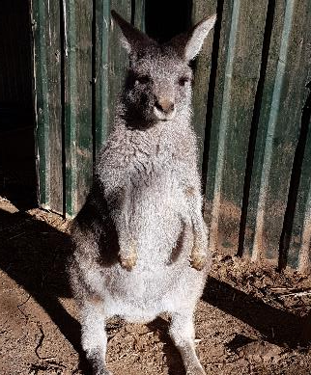
Test** |  | Normals*
Cortisol (nmol/ L) | 525 | <50**
Potassium (mmol/ L) | 6.5 | <6.6
Urea (mmol/ L) | 13.1 | 3.9 – 16.4
Creatinine (umol/ L) | 120 | 88 - 256
AST (U/ L) | 5121 | 8 - 325
Creatine Kinase (U/ L) * Vetnostics data. ** Possumwood research. | 356540 | 172 - 6020
Carrie
Fence hanger & attacked by dog while caught. Deep puncture wound to neck. Mother close by & probably saved her from the dog attack.

Slide 21
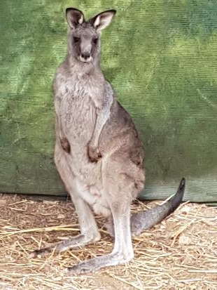
Test |  | Normals*
Cortisol (nmol/ L) | 170 | <50**
Potassium (mmol/ L) | 12.3* | < 6.6
Urea (mmol/ L) | 8.2 | 3.9 – 16.4
Creatinine (umol/ L) | 115 | 82 - 256
AST (U/ L) | 3650 | 8 - 325
Creatine Kinase (U/ L) | 216230 | 172 - 6020
Rovere
Found collapsed in a garden. Hypothermic, likely chased by dogs.
* Vetnostics data. ** Possumwood research.

Slide 22
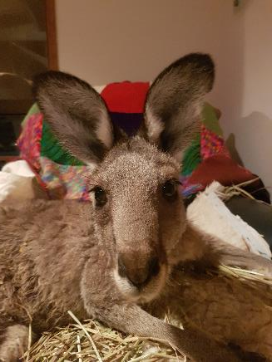
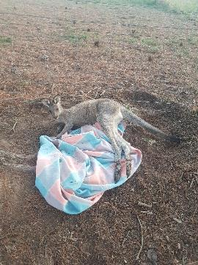
Test |  | Normals*
Cortisol (nmol/ L) | - | <50**
Potassium (mmol/ L) | 5.2 | < 6.6
Urea (mmol/ L) | 13.3 | 3.9 – 16.4
Creatinine (umol/ L) | 110 | 82 - 256
AST (U/ L) | 2625 | 8 - 325
Creatine Kinase (U/ L) * Vetnostics data. ** Possumwood research. | 137870 | 172 - 6020
Majura

Slide 23
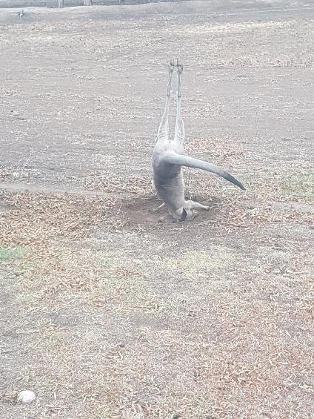
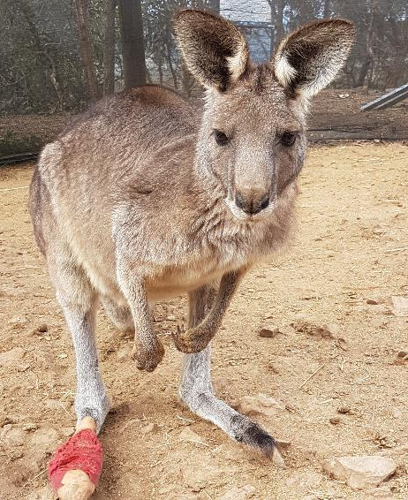
Test |  | Normal
Cortisol (nmol/ L) | 118 | <50
Macca

Slide 24
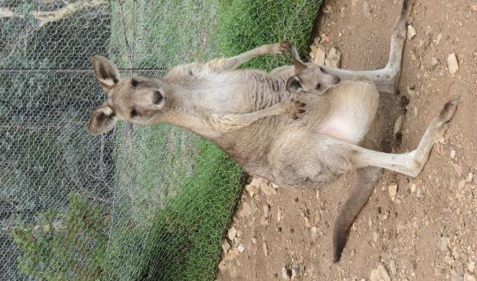

Treatment of stress myopathy
Diazepam (0.25 – 0.5mg/ kg SC or IM) – anxiolytic & muscle relaxant
Check temperature (tympanic thermometer - ear)
If hyperthermia (> 37) - cool animal (eg wet towels &
fan). Cool IV fluids most effective but not normally
necessary
If hypothermia (< 35) – warm animal (eg electric throw
rug) around trunk
It is very important to provide fluid therapy ASAP after
Incident. Initially 3% by weight SC NS. Fluids can be given IV
if necessary. Offer water or 1% glucose orally. orally
Emu – fence hanger survivor

Slide 25
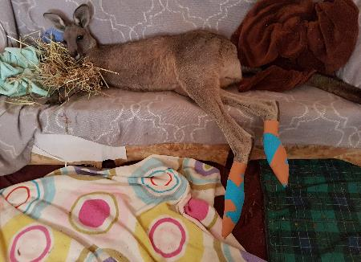
Treatment of stress myopathy (Cont)
If still tachypnoeic after Diazepam & cooling give
sodium bicarbonate intravenous infusion 8.4% – 1ml/kg SC, dose will likely need to be repeated
Analgesia – Tramadol 1mg/kg IM twice daily or Panadol 10mg/ kg twice daily
Vitamin E/Selenium – 1mg/ ml selenium & 50mg/ ml Vit E (0.05ml/ kg IM) once daily for 3 days
Optional – Haloperidol decanoate 50mg/ml (6mg/ kg),
Dexamethasone, Frusemide (Lasix) sometimes used
Dantrolene Sodium (1ml/ kg IV) is
mentioned in some texts as a skeletal
muscle relaxant but is expensive
Macca, fence hanger

