Slide 1
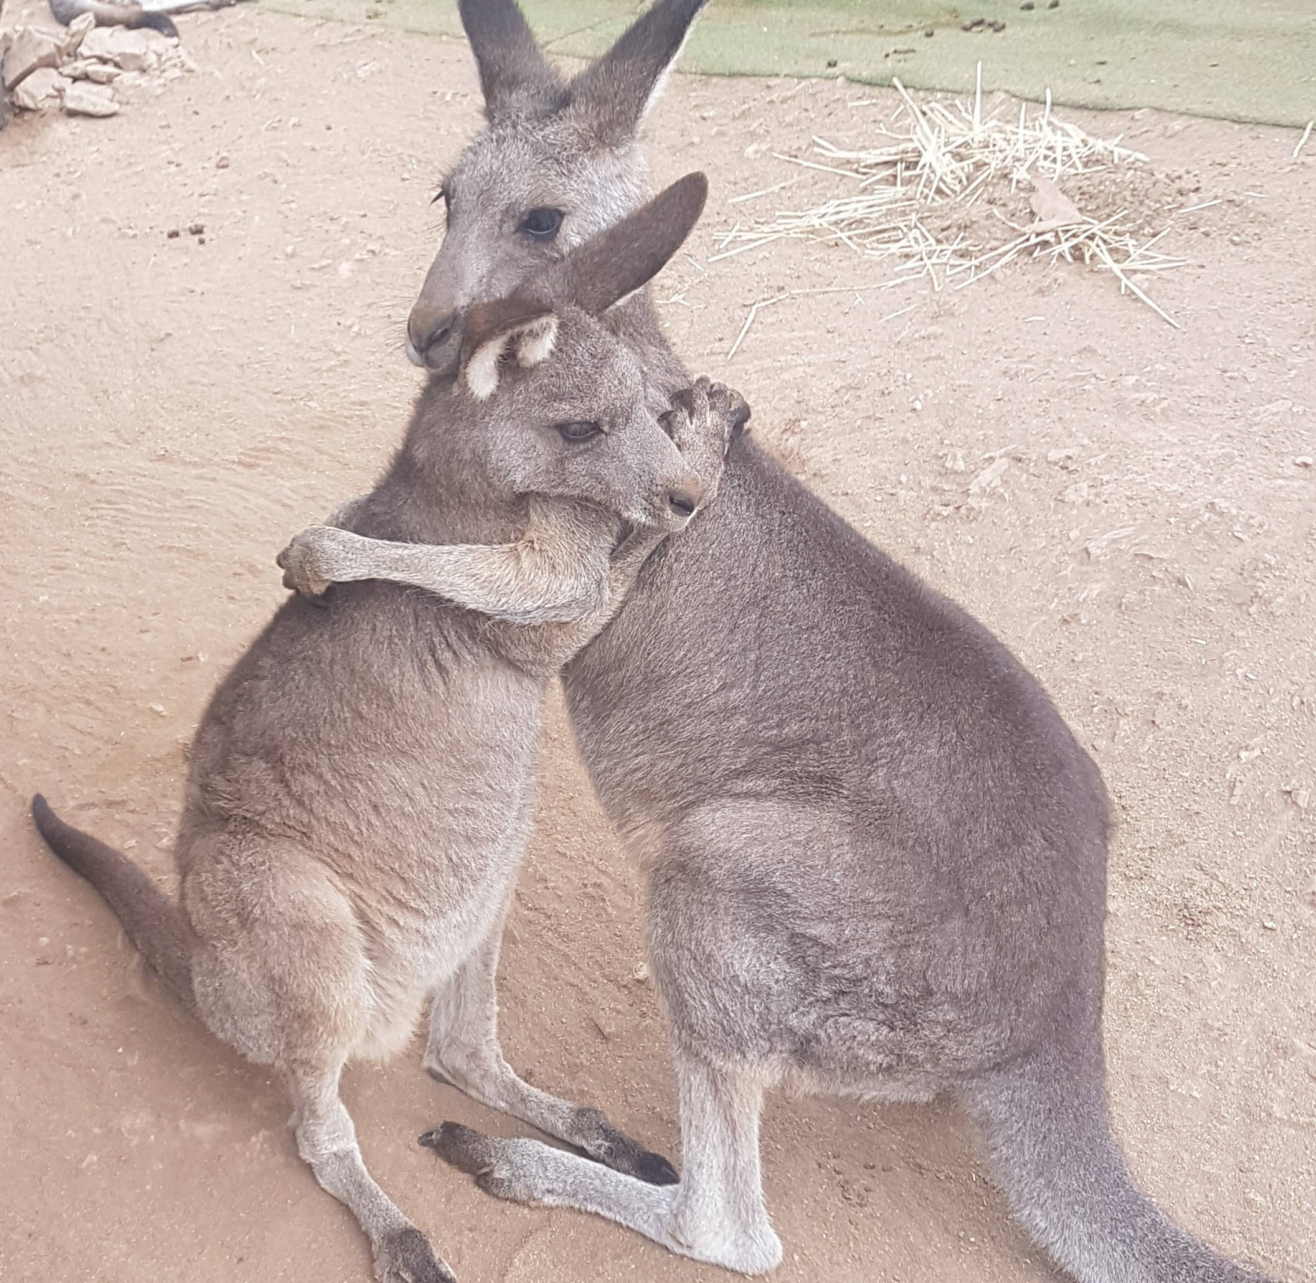
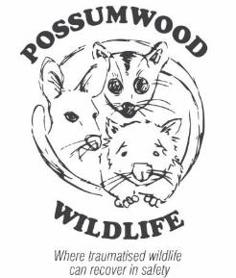
Quantifying Post-trauma Stress in Macropods and the Polyvagal Theory and Therapy in Stress Rehabilitation
Professor Steve Garlick
Dr Rosemary Austen

Slide 2
Overview
Macropod Emotions
Stress & its assessment
Data – Bushfire, Fence Entanglement, Dog attack
The Polyvagal theory
Its application in rehabilitation
The mystery of ‘shutdown’ & the question of ‘myopathy’

Slide 3
The emotional lives of macropods
[Ref: Garlick, S. and Austen, R. “Learning about the emotional lives of kangaroos, cognitive justice and environmental sustainability”. Journal of Relations: Beyond Anthropocentricism, 2014, 2 (1).]
Emotions are not spontaneous upwellings of arbitrary feelings. They are reactions to events. So if we can correlate emotional reactions with the events that trigger them, we can use these reactions as sources of information to help in recovery.
The emotional life of an animal is just as important for recovery as is his/her physical life.
    The veterinarian probably can't help you with that.
    Carers and rehabilitators spend 24/ 7 observing these emotional states

Slide 4
Observed Emotional & Cultural Behaviour
A ‘Being-for’ (Bauman form of engagement.
Six neural markers for kangaroos (joy, distress, anger, relaxation, nurturance, sexuality) seen through close engagement observation.
Each has several behavioural indicators (see table next slide).
Here we are interested in these neural markers as they relate to the incidence of life-threatening post-trauma stress and recovery from it.
We want to go beyond simple observation and into quantitative assessment.
In particular we are interested in the role of the autonomic nervous system in stress not only because it generates these neural states, but also because it also helps with the therapy and recovery process.

Slide 5
Observed Emotional Behaviour Markers in the Kangaroo
Neural states | Outward indicators (kangaroo)
Joy (play) | Hooning, kicking legs into the air, boxing with kin, chasing kin, eye expression.
Separation, distress (panic) | Vocal, running into objects in panic, wide eye expression, erect and extended posture, licking forearms, rapid respiratory rate, rapid pulse rate, high blood pressure, flared nostrils.
Nurturance (care) | Preening, embracing kin, body contact, protective behaviour by dominant males
Sexuality (lust) | Courtship behaviour, pairing, long-term male/female friendships
Anger (rage) | Vocal, eye expression, posture
Relaxation | Lying on back asleep, mothers relaxing pouch muscle, mothers allowing small infants to exercise outside pouch

Slide 6
Stress and the Autonomic Nervous System
ANS regulates the internal environment of the body such as temperature, heart rate, respiration rate, blood pressure and digestion and comprises:
  Sympathetic nervous system – prepares the body for ‘fight’ or ‘flight’ from a threat in the environment.
  Parasympathetic nervous system – helps regulate the body at rest (‘rest and digest’).

Slide 7
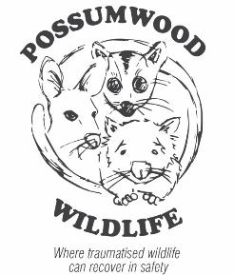
Sympathetic nervous system: Effects
Stimulates release of adrenalin – ‘adrenalin rush’
Stimulates glucose release from liver
Diverts blood away from GIT, kidneys and skin
Enhances blood flow to skeletal muscles (1200%) & lungs
Dilates bronchioles (airways) of lungs allowing better oxygen exchange
Increases heart rate and contractility of heart cells
Dilates cardiac blood vessels
Dilates pupils

Slide 8
Fight or Flight Response
Central Nervous System
Corticotropin Releasing Factor
Sympathetic nervous system
Pituitary Gland
Adrenocorticotropic Hormone
Adrenal medulla
Adrenal cortex
Adrenalin
Cortisol
Bloodstream
Neural activity combines with hormones in the blood to constitute the fight or flight response

Slide 9
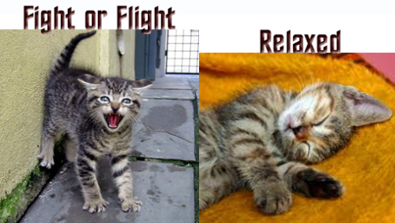
Fear factor
Overwhelming fear & anxiety trigger the sympathetic nervous system & release of hormones such as adrenalin and cortisol
Sympathetic - fight or flight
Parasympathetic ventral vagal – rest and digest

Slide 10
The Adrenalin Rush
Adrenalin contributes to the fight or flight response by:
increasing blood flow to the muscles
increasing output of the heart
pupil dilation
increasing blood glucose

Slide 11
Cortisol Contribution
Increasing blood pressure
Increasing blood glucose
Heightened attention
Decreasing sensitivity to pain.
As an analogy with respect to the fight or flight response, adrenalin puts the foot on the accelerator. As the initial adrenalin surge subsides, cortisol keeps the accelerator on. When the threat passes, the parasympathetic nervous system acts like a brake and dampens the stress response

Slide 12
Stress in Macropods
Pathophysiology not well understood and a paucity of knowledge in the literature eg Ladd, “Pathology of Australian Native Wildlife”, CSIRO Publishing
Trigger for a stress syndrome is stress caused by fear or anxiety.
Risk of death is increased by intense physical exertion (exertional rhabdomyolysis) .
Obvious triggers include macropod caught in a fence or chased by a motor vehicle or dogs, a joey separated from its mother, illness. Presentation after severe stress varies.
Some triggers are more subtle eg change in carer, relocation to release site or certain noises.
Personality of the animal also plays a role in whether significant stress develops.
Animals with anxiety traits are more likely to develop significant stress when exposed to a stressor.

Slide 13
Measuring Cortisol in Wildlife for
Post-trauma Assessment
Type | Advantages | Disadvantages
Blood | Cortisol data can be aligned with other biochemistry and haematology data. Sample can be correlated with the trauma circumstances. | Invasive, animal needs to be sedated for venal access. Hormonal analysis can be expensive.
Faecal | Non-invasive. Easily obtained. | May be difficult to assign sample with correct subject. Time delay in obtaining correct sample post-trauma. Frozen storage and centrifuge analysis.
Hair | Useful for chronic stress after 6 months of hair growth. Easy storage. | Not useful for acute stress. Animal needs to be captured.
Saliva | Easily obtained | Samples need to be taken throughout the day. Animal needs to be captured.
Urine | Non-invasive | Opportunistic access. Animal needs to be captured. Timing of urine collection vis a vis the stress event can be problematic. Cortisol can be influenced by urine concentration.

Slide 14
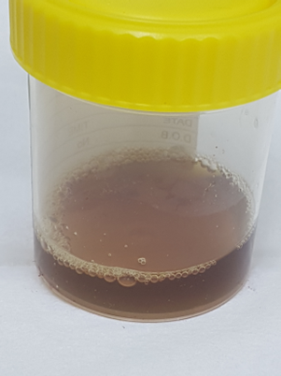
Exertional Rhabdomyolysis
Prolonged, strenuous muscle activity can cause exertional rhabdomyolysis especially in hot conditions and associated with dehydration.
The breakdown of the muscle tissue releases the muscle protein myoglobin, enzymes – creatine kinase (CK), AST/ ALT, and potassium into the blood.
The myoglobin results in dark brown or what is known as ‘Coca Cola’ urine and can result in kidney damage and consequent renal failure.

Slide 15
Selected cases – Cortisol & CK data
Being burnt in wildfires
Being caught in wire fences
Being chased & attacked by dogs

Slide 16
Black Summer Bush Fires
Name | Date | CK | Cort | Date | CK | Cort
Steff | 31/1/20 | 6825 | 112 | 15/4/20 | 4867 | 36
Cinders | 5/2/20 | 6097 | 178 | 25/3/20 | 1093 | 46
Sparkles | 5/2/20 | 3872 | 161 | 15/3/20 | 370 | 24
Kenny 5/2/20 4281 170 7/2/20 11664 87
Shannon | 26/1/20 | 2568 | 362 | 15/3/20 | 9965 | 98
CK Normal 203-6868 U/L
CORT Normal < 50nmol

Slide 17
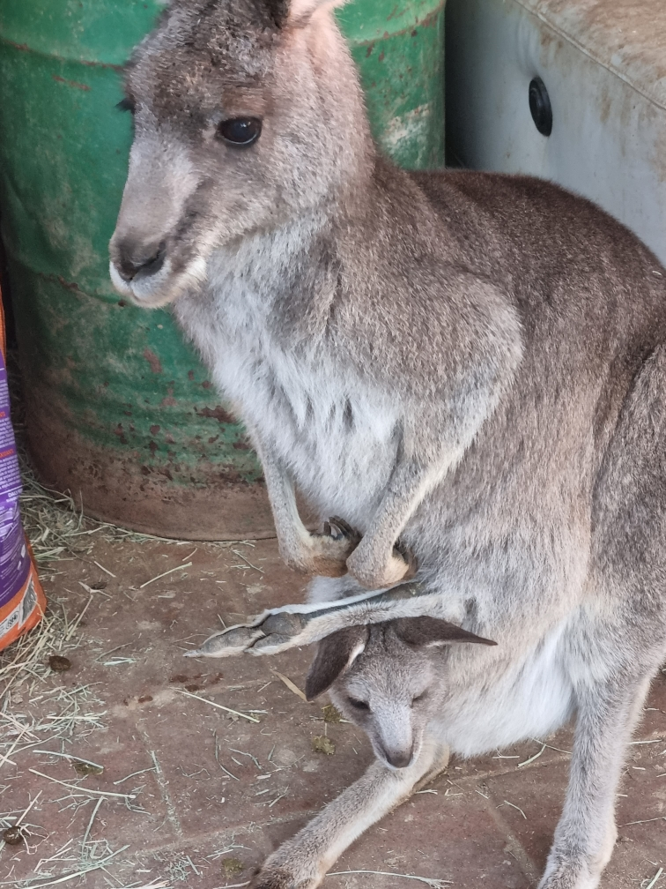
Cinder’s story
One of the 30 burns cases brought to Possumwood. One of the worst burns cases.
Cinders, 3 ½ years after rescue, treatment and her recovery from the fires.
Like the other kangaroos rescued and treated at Possumwood after the fires, she spent her rehabilitation with others inside receiving attention
.
Cinders has been released successfully and has had joeys.
Cinders

Slide 18
Observations from the burns case data
CK approximates normal levels and generally declines further when in a safe care situation.
Those rescued directly from the fires and brought to Possumwood generally had high cortisol levels (eg Steff, Cinders, Sparkles and Shannon).
Those coming two months later from other triage centres with different housing and treatment protocols had higher cortisol levels.
Cortisol levels in both cases dropped significantly while in care at Possumwood.
The post-treatment care regime for the burns cases at Possumwood included:
  Inside recovery
  Group situation recovery
  Constant engagement with Possumwood staff including physio, dressing changes, etc.

Slide 19
Wire Fence Entanglement
Name | Date | CK | CORT | Outcome
Kelly | 2/11/21 | 98811 | 584 | Died
Brooks | 15/11/21 | 99774 | 337 | Released
William | 16/10/21 | 3158 | 202 | Released
Bates | 18/10/21 | 79651 | 295 | Released
Cinnamon | 23/7/22 | 57288 | 125 | In-care
Goliath | 17/8/21 | 9398 | 236 | Died
McGooley | 14/1/22 | 97164 | 196 | Died
Tatiana | 16/3/22 | 121722 | 326 | Died
Gide | 18/12/21 | 23499 | 347 | Died
Springer | 6/3/22 | 178210 | 262 | Released
Timon2 | 5/3/22 | 22588 | 230 | In-care
Ginni | 15/2/22 | 102048 | 588 | In-care
George | 15/2/22 | 244716 | 342 | Died
Basil | 12/6/23 | 731850 | 152 | In-care
Diego | 16/9/22 | 122308 | 233 | In-care
CK Normal 203-6868 U/L
CORT Normal < 50nmol

Slide 20
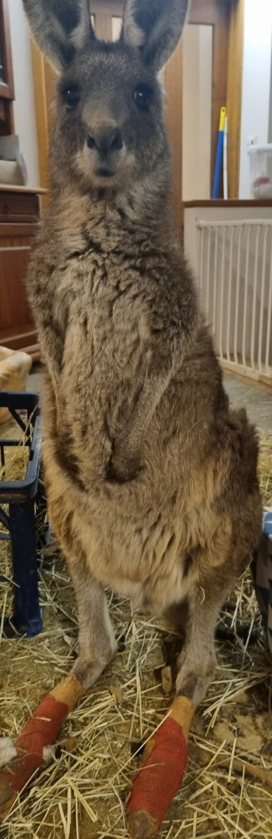
Basil’s story
Markedly elevated CK and Cort levels on rescue from fence entanglement. Caught by both legs.
After 5 weeks in care he is doing very well. Can get up and stand for long periods, hopping.
Basil

Slide 21
Observations from the fence hanger data
Both CK and Cort can be markedly elevated.
With the right treatment and rehab, many recover and are eventually released after weeks or months depending on various factors (presence of lactic acidosis, age, severity of injuries, etc)
  Fluids & metabolic acidosis treatment if needed
  Antibiotics & other cover (tetanus, cocci, other parasites)
  Wound cleaning & dressing
Rehab conditions & program
  Indoor shared accommodation (Isolation from others does not work and in fact can be detrimental)
  Physio
  Attachment (choice of roommates is important eg. stage of recovery & personality)
  Regular communication.

Slide 22
Dog Attack
Name | Date | CK | Cort | Date | CK | Cort | Outcome
Boxer | 28/10/21 | 20654 | 302 |  |  |  | Released
Cherry Blossum | 5/7/22 | 139826 | 242 | 22/7/22 | 705 | 59 | Released
Woola | 3/5/23 | 16074 | 349 | 8/5/23 | 4990 | 204 | Released
Carrie |  | 356540 | 525 |  |  |  | Released
Swallow | 25/3/19 | 82900 | 531 | 18/4/19 | 1829 | 26 | Died
Big Al | 26/6/18 |  | 431 |  |  |  | Released
Rovere |  | 216230 | 170 |  |  |  | Released
Betty |  | 17633 | 803 |  |  |  | Released
CK Normal 203-6868 U/L
CORT Normal < 50nmol

Slide 23
Dog Attack Recovery Over Time
Cherry Blossum. Attacked by two Maremma dogs. When rescued she was suffering from exertional rhabdomyolysis (indicated by the very high CK). She was in a sympathetic flight or fight state (indicated by the very high cortisol). You can see that over time the exertional rhabdomyolysis resolves as shown by the decrease in the CK. She was housed inside with three other quiet macropods and received a lot of gentle attention from her carers. Her anxiety decreased as evidenced by the drop in cortisol (a switch from the sympathetic to the parasympathetic).
Date | CK | CORT
5/7/22 | 139,826 | 242
6/7/22 | 52,253 | 154
11/7/22 | 8351 | 96
22/7/22 | 705 | 59
CK Normal 280 – 2790 U/L
CORT Normal < 50nmol

Slide 24
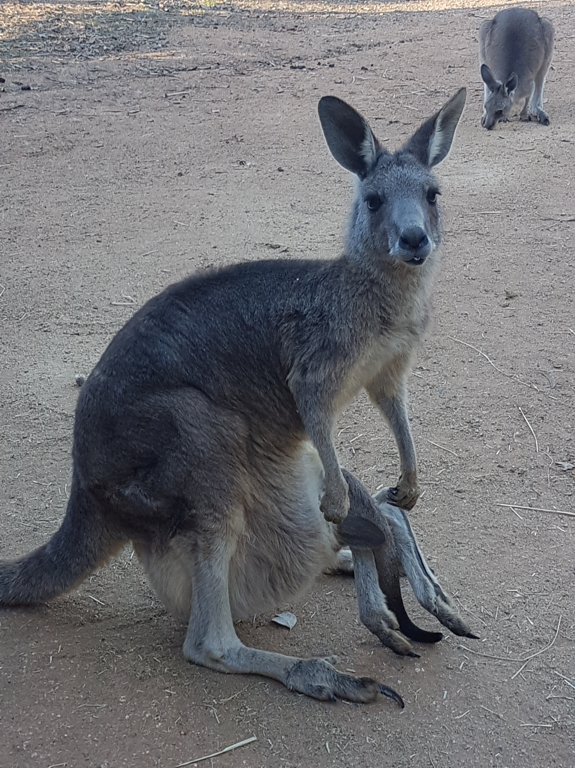
Carrie’s story
Markedly elevated CK (356540) and
Cort (525).
A fence hanger attacked by a dog while hanging in the fence.
She had a severe neck wound from the dog attack and broken teeth from hitting the ground when she got her feet caught in the wire fence
Carrie

Slide 25
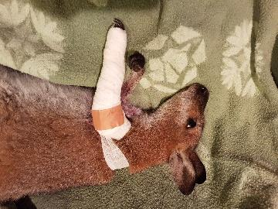
Test | 21/ 03/ 2019 | 16/04/2019 | Normal *
Cortisol (nmol/ L) | 531 | 56 | <50**
Potassium (mmol/ L) | 5.7 | 4.6 | 2.2-8.2
Urea (mmol/ L) | 18.8 | 6.9 | 4.3-17.1
Creatinine (umol/ L) | 120 | 55 | 44-168
AST (U/ L) | 3343 | 96 | 30-281
Creatine Kinase (U/ L) * Vetnostics data. **Possumwood research. | 82900 | 1829 | 203-6868
Swallow
Female Red Neck wallaby attacked by two dogs. Arm severe lacerations and fractures, bites to legs and neck. Small pinkie in pouch died.

Slide 26
Observations from Dog Attack Data
Need to act quickly to rescue & treat
Markedly elevated CK & Cort
With treatment & rehab both CK and Cort can be significantly reduced in a short time (eg Cherry).
Most survive to be released following rehab.

Slide 27
Three Stress Categories
1. Switch from Fight or Flight to Rest & Digest
  1(a): High Cortisol/ Low CK, e.g. wildfire burns victims
  1(b): High Cortisol/ High CK, eg fence hangers and dog attack victims.
2: Stuck in Fight or Flight (unable to switch) – stress repeat leading to death (eg Iggy, McGooley)
3: Shutdown – relentless decline in vital signs (eg heart rate, respiration rate, blood pressure, temperature) with resultant respiratory arrest and death.

Slide 28
Stress – Category 2: The case of Iggy
  Less common
  Ongoing fight or flight state (PTSD)
  Rapid progression to death after a subsequent stress
  trigger (even if mild).
  Iggy. Mother euthanased, alone for three days, harassed by dogs and then darted and brought into care at 3.5kg. Always hypervigilant, thought to have PTSD. After a minor stressor, Iggy went into a trance-like state – recumbent, muscle fasciculation, respiratory arrest and death within one hour.? The shutdown state of the polyvagal theory.

Slide 29
Stress Category 3: The case of Toto
We have observed that some macropods at rescue are already going into shut down. It has also been observed that some animals go into shutdown after rescue, especially if housing conditions are not ideal. These animals are under- responsive, are or are becoming hypothermic, bradycardic and bradypnoeic. They progress to respiratory arrest and death.
Name | CK | Cort | Temp | HR | RR | BP
Toto (10kg) | 13009 | 257 | 32.4 | 60 | 14 | 102/42

Slide 30
Polyvagal Theory: ANS and Vagal Nervous System
Stephen Porges (“The Polyvagal Theory: Neurophysiological Foundations of Emotions, Attachment, Communication & Self-regulation”, 2011)
Sympathetic nervous system
Parasympathetic Nervous System
  Dorsal Vagal nervous system
  Ventral Vagal nervous system
Studies with animals

Slide 31
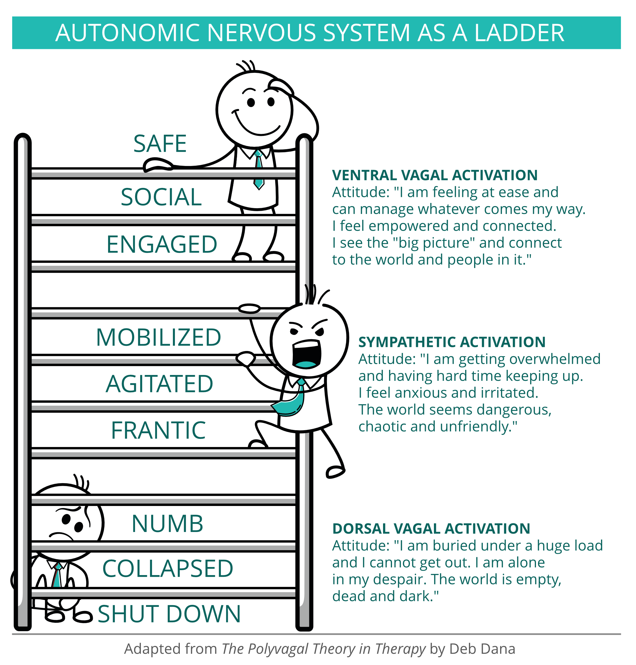
The Polyvagal Theory in Action
The autonomic nervous system
  Sympathetic & Parasympathetic nervous systems
The Vagus nerves of the parasympathetic nervous system
  Ventral vagus branch -
  Dorsal vagus branch –
The Polyvagal Ladder – a continuous loop of emotional &
behavioural movement between three states
  Rest & digest (social engagement & rest)
  Fight or flight (mobilisation)
  Shutdown (immobilisation) –trance-like

Slide 32
Neuroception – interpreting safety and risk
In the ANS, Neuroception is the immediate interpretation of stimuli without conscious input from the brain.
  Neuroception precedes perception.
  The ANS is a surveillance system - always monitoring stimuli and asking the question ‘is this safe?’
  Fence injured macropods – limited mobility increases the risk interpretation and consequent action.
    Burns cases in recovery
    Luna and Karolina (single carer)
    Basil – changing the environment
    Carl – housing and multiple carers.

Slide 33
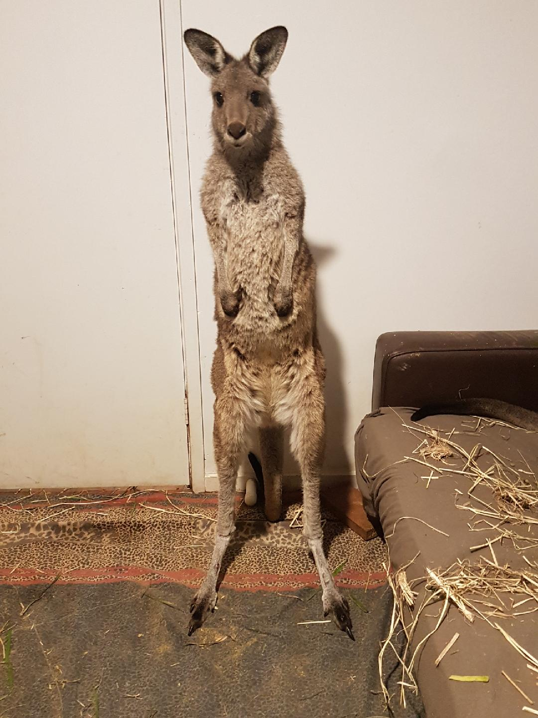
Fight or Flight (ready for action) Sympathetic
Luna

Slide 34
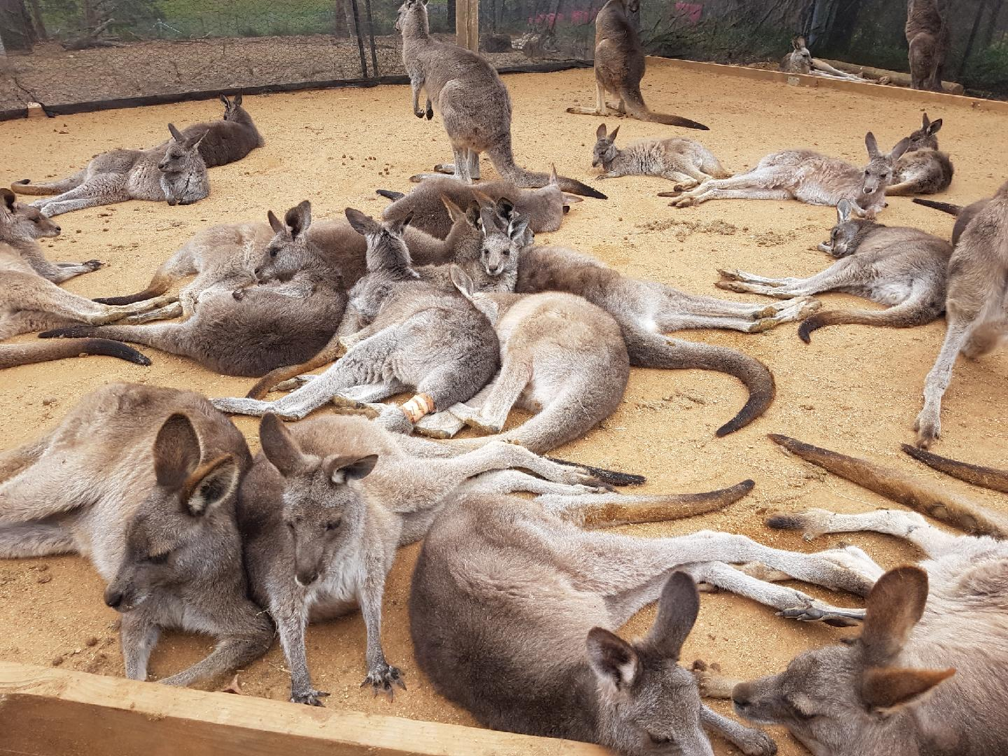
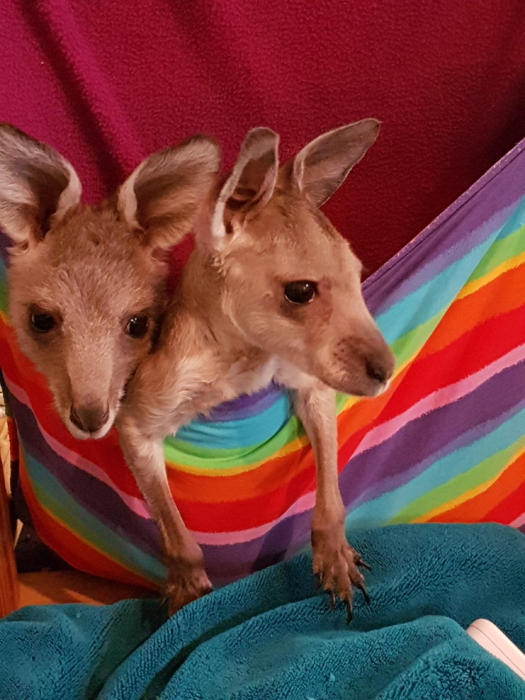
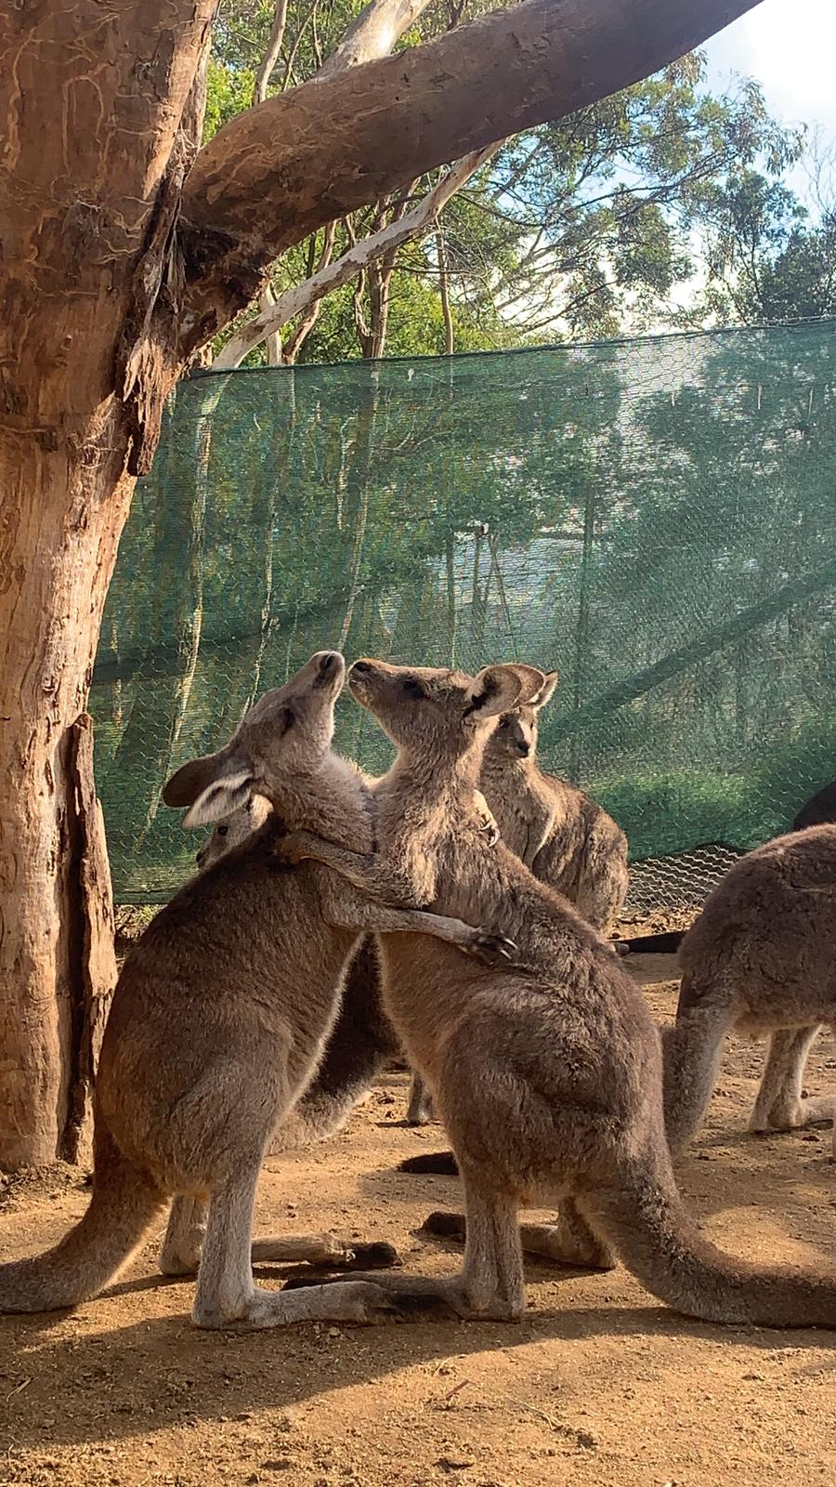
Rest & digest (safe, socially engaged)
Parasympathetic - Ventral Vagal

Slide 35
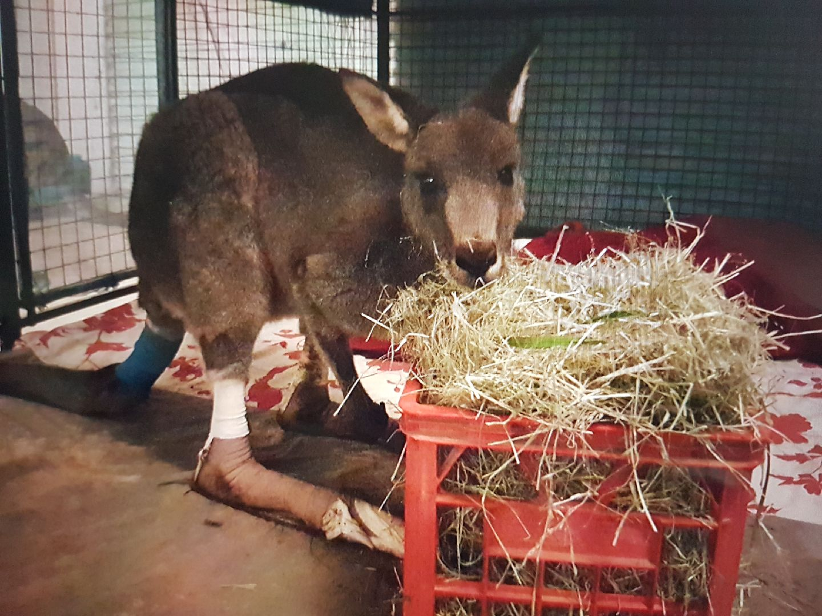
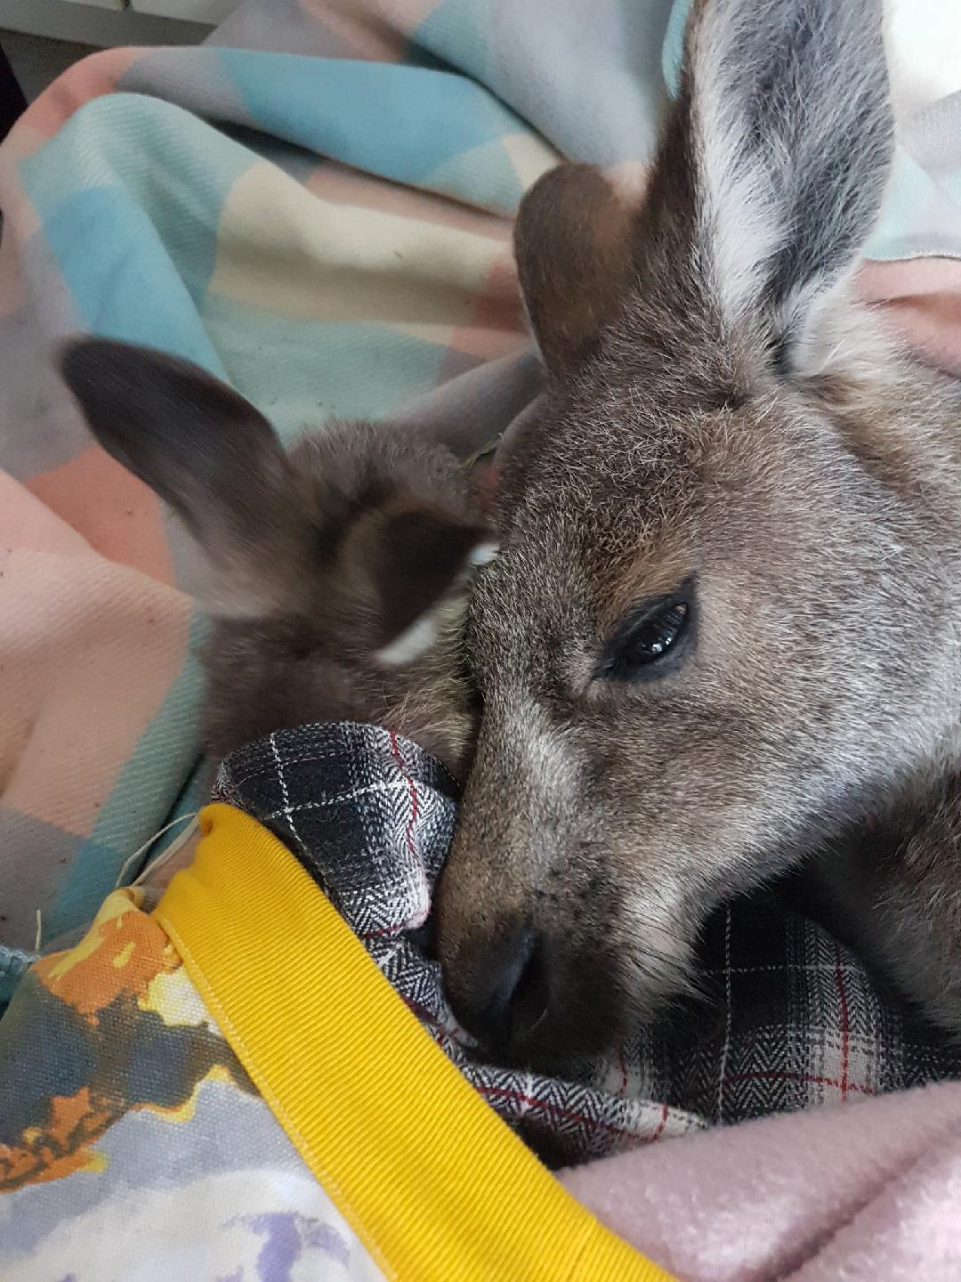
Shutdown
Dorsal Vagal
Mike (CK 2272, CORT 93)
Mary

Slide 36
Polyvagal Rehabilitation: Self-regulation, attachment, communication & support
Self-regulation
Attachment
Communication
Environmental support (housing, group dynamic)
Medication support?

Slide 37
The mystery of shutdown and the question of myopathy in macropods
We propose the term myopathy is a misnomer. The animals don’t die from muscle pathology – they die because their body functions shut down.
How can we switch a macropod from shutdown back to fight or flight and then into rest & digest?
This is a question we are working on at Possumwood.

Slide 38
Thank You

